Slide 1


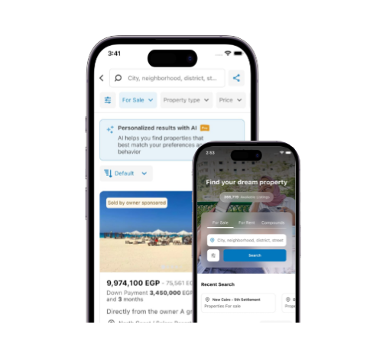
AQARMAP EGYPT
The Real Estate Intelligence Marketplace
Buy, sell, and rent properties online
Connects buyers with top developers
Egypt’s specialized real estate platform
Target: Buyers, Investors, and Brokers
Type: E-Business with E-Commerce features

Slide 2

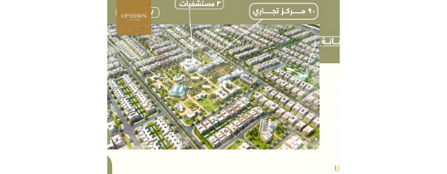


Features and Solutions
Smart Search: Location & price filters
Price Guide: Know the meter price
Compound Guide: 1,200+ projects
Problem Solved: Saves search time
Vs Others: Pure real estate focus

Slide 3

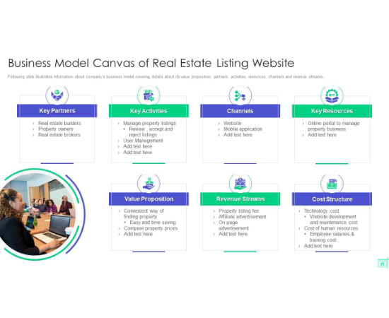
Business Model & Revenue
Revenue Channels:
B2B: Developers pay for branding
Premium Listings: Featured visibility
Subscriptions: Broker monthly plans
Lead Generation: Quality buyer data
Online Expos: Digital booking fees

Slide 4






Security & The Future
Secure Portal
Why it Succeeds
Future AI
Verified agents and data encryption for safe browsing.
High local real estate demand + Specialized UX.
AI recommendations and Virtual Reality (VR) tours.

Slide 5

ANY QUESTIONS?
Thank You for Your Attention
Visit us: aqarmap.com.eg

